Slide 1
Database Techniques
Martin Kersten @ cwi.nl
http://www.cwi.nl/~manegold/teaching/DBtech

Slide 2
Relational systems
Prerequisite knowledge
  Relational data model
  SQL
  Relational algebra
  Data structures (b-tree, hash)
  Operating system concepts
  Running SQL queries
What is the practical experience?

Slide 3
Code bases
Database management systems are BIG software systems
  Oracle, SQL-server, DB2 >10 M lines
  PostgreSQL 850K lines
  MySQL >1M K lines
  MonetDB 1.2 M lines (300 K *.mx)
  SQLite 140K lines
Programmer teams for DBMS kernels range from a few to a few hundred

Slide 4
Performance components
Hardware platform
Data structures
Algebraic optimizer
SQL parser
Application code
  What is the total cost of execution ?
  How many tasks can be performed/minute ?
  How good is the optimizer?
  What is the overhead of the datastructures ?

Slide 5
Not all are equal
 | MonetDB | PostgreSQL | MySQL | SQLite | SQLlite nosync
1000 inserts transactions | 0.27 | 4.30 | 0.15 | 13.06 | 0.22
25000 inserts 1 transaction | 6.71 | 4.91 | 2.18 | 0.94 | 1.42
100 range selects | 0.18 | 3.62 | 2.76 | 2.49 | 2.52
100 string range selects | 2.15 | 13.40 | 4.64 | 3.36 | 3.37
5000 range index selects | 5.22 | 4.61 | 1.27 | 1.12 | 1.16
1000 updates | 0.43 | 1.73 | 8.41 | 0.63 | 0.63
25000 updates with index | 8.33 | 18.79 | 8.13 | 3.52 | 3.10
25000 updates on text | 10.32 | 48.13 | 6.98 | 2.40 | 1.72
Insert from select | 0.65 | 61.36 | 1.53 | 2.78 | 1.59
Delete on text index | 0.32 | 1.50 | 0.97 | 4.00 | 0.56
Delete with index | 0.22 | 1.31 | 2.26 | 2.06 | 0.75
Big insert after delete | 0.36 | 13.16 | 1.81 | 3.21 | 1.48
Big delete and small insert | 0.93 | 4.55 | 1.70 | 0.61 | 0.40

Slide 6
Monet experiment
What is the throughput of simple API interactions?
A single 20K length session interaction with V4.3.13 and V5 using the same Perl DBI application
clients V4 V4/throughput V5 V5/throughput
1 19.1 1047/sec 18.3 1092/sec
2 29.9 1339/sec 24.8 1612/sec
4 59.1 1353/sec 55.9 1431/sec
8 120 1333/sec 101 1584/sec
Switching to C-api
clients V4 V4/throughput V5 V5/throughput
1 3.2 6250/sec 3.0 6666/sec
2 5.1 7843/sec 4.2 9523/sec
4 17.1 4678/sec 8.1 9876/sec
8 35 4571/sec 16.2 9876/sec

Slide 7
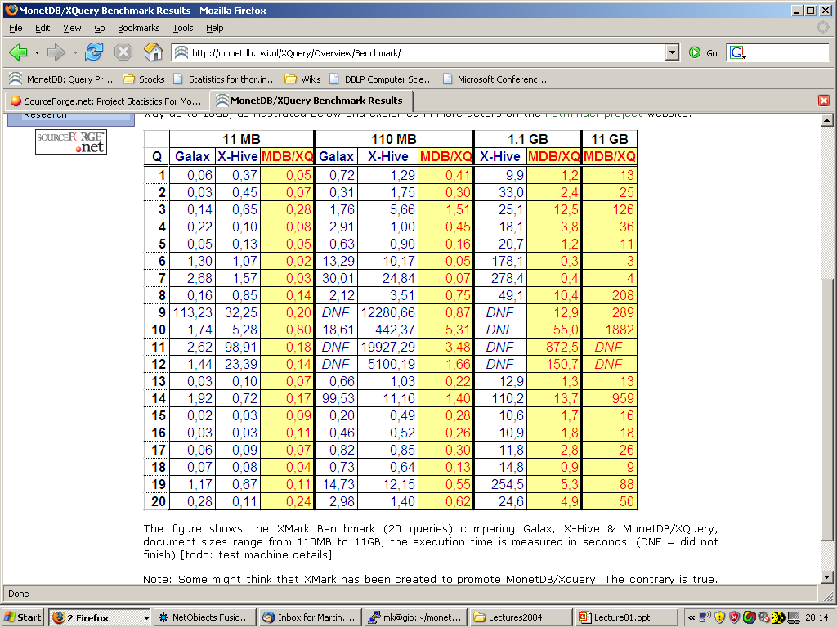

Slide 8
-- DBtapestry Version=1.1
-- See http://monetdb.cwi.nl/<tobedefined>
-- (c) CWI 2004-2005 - All rights reserved
-- --scenario=tapestry --target=sqlserver
-- --name=tapestry --rows=1024K --columns=32
-- Produced Wed Jan 26 20:02:53 2005
begin transaction;
declare @starttime datetime
set @starttime = getdate();
create table RKA( head int, tail int);
create table RKB( head int, tail int);
insert into RKA values(0,0);
insert into RKA values(1,360);
insert into RKA values(2,427);
insert into RKA values(3,160);
  Continue with this until you have 1K tuples

Slide 9
insert into RKA values(1022,350);
insert into RKA values(1023,864);
… Now we have 1K elements
… Duplicate this table till you reach the target size
insert into RKB
select head+0, tail+0
from RKA;
insert into RKB
select head+240640, tail+240640
from RKA;
insert into RKB
select head+923648, tail+923648
from RKA;
… Another 100-10000 bulk inserts

Slide 10
insert into RKB
select head+324608, tail+324608
from RKA;
drop table RKA;
… Now we have the desired size for a binary table
… shuffle the tail to ensure random distribution
update RKB set tail=(tail*47) % 1048576;
update RKB set tail=(tail*43) % 1048576;
update RKB set tail=(tail*41) % 1048576;
update RKB set tail=(tail*37) % 1048576;
update RKB set tail=(tail*31) % 1048576;
update RKB set tail=(tail*29) % 1048576;
update RKB set tail=(tail*23) % 1048576;
update RKB set tail=(tail*19) % 1048576;
update RKB set tail=(tail*17) % 1048576;

Slide 11
create table tapestry( attr0 int , attr1 int, attr2 int, attr3 int, attr4 int, attr5 int, attr6 int, …. int, attr29 int, attr30 int, attr31 int);
insert into tapestry
select R0.head, R0.tail , R1.tail, R2.tail, R3.tail, R4.tail, R5.tail, R6.tail, … R29.tail, R30.tail
from RKB R0,RKB R1,RKB … R27,RKB R28,RKB R29,RKB R30
where
R1.head = R0.tail
and R2.head = R1.tail
and R3.head = R2.tail
and R4.head = R3.tail
….
and R27.head = R26.tail
and R28.head = R27.tail
and R29.head = R28.tail
and R30.head = R29.tail
Hurray, we have 1Mx32 Tapestry

Slide 12
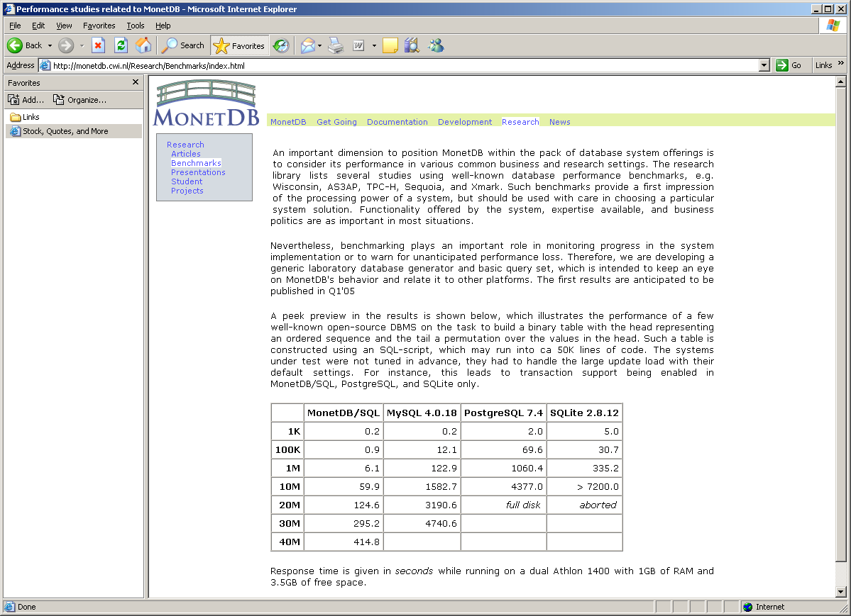
Why does it take so long to built a 10Mx2 table?
How long will it take to do 10Mx32 on SQLserver Beta 2 ?

Slide 13
Gaining insight
Study the code base (inspectionv+profiling)
  Often not accessible outside development lab
Study individual techniques (data structures+simulation)
  Focus of most PhD research in DBMS
    Detailed knowledge becomes available, but ignores the total cost of execution.
Study as a black box
  Develop a representative application framework
    Benchmarks !

Slide 14
Performance Benchmarks

Slide 15
Performance Benchmarks
Suites of tasks used to quantify the performance of software systems
Important in comparing database systems, especially as systems become more standards compliant.
Commonly used performance measures:
  Throughput (transactions per second, or tps)
  Response time (delay from submission of transaction to return of result)
  Availability or mean time to failure

Slide 16
Benchmark design
Benchmark suite structures
  Simple, one shot experiment
    time to set-up a connection with a db server
    Selection processing for multiple selectivity factors
  Complex, multi-target experiments
    Geared at supporting a particular domain
    To study the behavior of the DBMS software

Slide 17
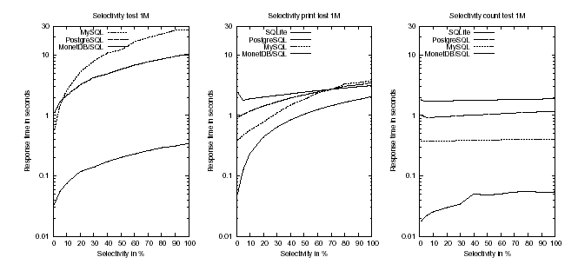
Not all are equal

Slide 18
Benchmark Design
Multi-target benchmark components:
  An application context
  A database schema
  A database content
  A query workload
These components can be fixed upfront or be generated dynamically

Slide 19
Benchmark design
The key question for any benchmark proposal:
  The ratio for its design
  Its ability to differentiate systems
  Its ability to highlight problematic areas
  Its repeatability on multiple platforms

Slide 20
Case study: Wisconsin benchmark
Designed in 1981 to study the query performance of database algorithms on a single user system
Used extensively over the last 20 years to assess maturity of a kernel
The results published caused legal problems for the authors

Slide 21
Case study: Wisconsin Benchmark
Wisconsin Benchmark components
  Single schema
  Relations: ONEKTUP, TENKTUP1,TENKTUP2
  Workload: 32 simple SQL queries
  Metric: response time
Key design issue is to be able to predict the outcome of a query
  DBMS testing; optimizer cost-model design

Slide 22
Case study: Wisconsin Benchmark
CREATE TABLE TENKTUP1
( unique1 integer NOT NULL,
unique2 integer NOT NULL PRIMARY KEY,
two integer NOT NULL,
four integer NOT NULL,
ten integer NOT NULL,
twenty integer NOT NULL,
hundred integer NOT NULL,
thousand integer NOT NULL,
twothous integer NOT NULL,
fivethous integer NOT NULL,
tenthous integer NOT NULL,
odd100 integer NOT NULL,
even100 integer NOT NULL,
stringu1 char(52) NOT NULL,
stringu2 char(52) NOT NULL,
string4 char(52) NOT NULL
)
Sort order, clustering
unique1 0-9999 random candidate key
unique2 0-9999 random declared key
Secondary index

Slide 23
Case study: Wisconsin Benchmark
CREATE TABLE TENKTUP1
( unique1 integer NOT NULL,
unique2 integer NOT NULL PRIMARY KEY,
two integer NOT NULL,
four integer NOT NULL,
ten integer NOT NULL,
twenty integer NOT NULL,
hundred integer NOT NULL,
thousand integer NOT NULL,
twothous integer NOT NULL,
fivethous integer NOT NULL,
tenthous integer NOT NULL,
odd100 integer NOT NULL,
even100 integer NOT NULL,
stringu1 char(52) NOT NULL,
stringu2 char(52) NOT NULL,
string4 char(52) NOT NULL
)
Cyclic numbers, e.g.
0,1,2,3,4,0,1,2,4,0….
Selectivity control
Aggregation
Non-clustered index

Slide 24
Case study: Wisconsin Benchmark
CREATE TABLE TENKTUP1
( unique1 integer NOT NULL,
unique2 integer NOT NULL PRIMARY KEY,
two integer NOT NULL,
four integer NOT NULL,
ten integer NOT NULL,
twenty integer NOT NULL,
hundred integer NOT NULL,
thousand integer NOT NULL,
twothous integer NOT NULL,
fivethous integer NOT NULL,
tenthous integer NOT NULL,
odd100 integer NOT NULL,
even100 integer NOT NULL,
stringu1 char(52) NOT NULL,
stringu2 char(52) NOT NULL,
string4 char(52) NOT NULL
)
50 groups, 2% each
Cyclic assigned

Slide 25
Case study: Wisconsin Benchmark
CREATE TABLE TENKTUP1
( unique1 integer NOT NULL,
unique2 integer NOT NULL PRIMARY KEY,
two integer NOT NULL,
four integer NOT NULL,
ten integer NOT NULL,
twenty integer NOT NULL,
hundred integer NOT NULL,
thousand integer NOT NULL,
twothous integer NOT NULL,
fivethous integer NOT NULL,
tenthous integer NOT NULL,
odd100 integer NOT NULL,
even100 integer NOT NULL,
stringu1 char(52) NOT NULL,
stringu2 char(52) NOT NULL,
string4 char(52) NOT NULL
)
Strings 52 chars long
$xxx..25..xxx$xxx..25..xxx$
$ is replaced by A-Z
Stringu1, stringu2 are keys
String4 contains 4 different

Slide 26
Case study: Wisconsin Benchmark
Comments on old database structure
  Tuple size (203 bytes) dictated by the page size
  Relation size dictated by low memory, e.g. a 2 megabyte database was almost a complete disk
Redesign and scaling up
  Relation size increased to 100K and beyond
  Cyclic values -> random to generate more realistic distribution
  Strings start with 7 different char from A-Z

Slide 27
Case study: Wisconsin Benchmark
Query benchmark suite aimed at performance of
  Selection with different selectivity values
  Projection with different percentage of duplicates
  Single and multiple joins
  Simple aggregates and aggregate functions
  Append, delete, modify
Queries may use (clustered) index

Slide 28
Case study: Wisconsin Benchmark
The speed at which a database system can process a selection operation depends on a number of factors including:
1) The storage organization of the relation.
2) The selectivity factor of the predicate.
3) The hardware speed and the quality of the software.
4) The output mode of the query.

Slide 29
Case study: Wisconsin Benchmark
The selection queries in the Wisconsin benchmark explore the effect of each and the impact of three different storage organizations :
1) Sequential (heap) organization.
2) Primary clustered index on the unique2 attribute. (Relation is sorted on unique2 attribute)
3) Secondary, dense, non-clustered indices on the unique1 and onePercent attributes.

Slide 30
Case study: Wisconsin Benchmark
Query 1 (no index) & Query 3 (clustered index) - 1% selection
INSERT INTO TMP
SELECT * FROM TENKTUP1
WHERE unique2 BETWEEN 0 AND 99
Query 2 (no index) & Query 4 (clustered index) - 10% selection
INSERT INTO TMP
SELECT * FROM TENKTUP1
WHERE unique2 BETWEEN 792 AND 1791

Slide 31
Case study: Wisconsin Benchmark
Query 5 - 1% selection via a non-clustered index
INSERT INTO TMP
SELECT * FROM TENKTUP1
WHERE unique1 BETWEEN 0 AND 99
Query 6 - 10% selection via a non-clustered index
INSERT INTO TMP
SELECT * FROM TENKTUP1
WHERE unique1 BETWEEN 792 AND 1791

Slide 32
Case study: Wisconsin Benchmark
The join queries in the benchmark were designed to study the effect of three different factors:
1) The impact of the complexity of a query on the relative performance of the different database systems.
2) The performance of the join algorithms used by the different systems.
3) The effectiveness of the query optimizers on complex queries.

Slide 33
Case study: Wisconsin Benchmark
JoinABprime - a simple join of relations A and Bprime where the cardinality of the Bprime relation is 10% that of the A relation.
JoinASelB - this query is composed of one join and one selection. A and B have the same number of tuples. The selection on B has a 10% selectivity factor, reducing B to the size of the Bprime relation in the JoinABprime query. The result relation for this query has the same number of tuples as the corresponding JoinABprime query.

Slide 34
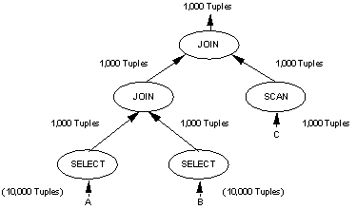
Case study: Wisconsin Benchmark
JoinCselASelB

Slide 35
Case study: Wisconsin Benchmark
Query 9 (no index) and Query 12 (clustered index) - JoinAselB
INSERT INTO TMP
SELECT * FROM TENKTUP1, TENKTUP2
WHERE (TENKTUP1.unique2 = TENKTUP2.unique2)
AND (TENKTUP2.unique2 < 1000)
Query to make Bprime relation
INSERT INTO BPRIME
SELECT * FROM TENKTUP2
WHERE TENKTUP2.unique2 < 1000

Slide 36
Case study: Wisconsin Benchmark
Query 16 (non-clustered index) - JoinABprime
INSERT INTO TMP
SELECT * FROM TENKTUP1, BPRIME
WHERE (TENKTUP1.unique1 = BPRIME.unique1)
Query 17 (non-clustered index) - JoinCselAselB
INSERT INTO TMP
SELECT * FROM ONEKTUP, TENKTUP1
WHERE (ONEKTUP.unique1 = TENKTUP1.unique1)
AND (TENKTUP1.unique1 = TENKTUP2.unique1)
AND (TENKTUP1.unique1 < 1000)

Slide 37
Case study: Wisconsin benchmark
Implementation of the projection operation is normally done in two phases in the general case.
First a pass is made through the source relation to discard unwanted attributes.
A second phase is necessary in to eliminate any duplicate tuples that may have been introduced as a side effect of the first phase (i.e. elimination of an attribute which is the key or some part of the key).

Slide 38
Case study: Wisconsin Benchmark
Query 18 - Projection with 1% Projection
INSERT INTO TMP
SELECT DISTINCT two, four, ten, twenty, onePercent, string4
FROM TENKTUP1
Query 19 - Projection with 100% Projection
INSERT INTO TMP
SELECT DISTINCT two, four, ten, twenty, onePercent, tenPercent, twentyPercent, fiftyPercent, unique3, evenOnePercent, oddOnePercent, stringu1, stringu2, string4
FROM TENKTUP1

Slide 39
AS3AP Benchmark
ANSI SQL Standard Scalable and Portable (AS3AP) benchmark for relational database systems. It is designed to:
• provide a comprehensive but tractable set of tests for database processing power.
• have built in scalability and portability, so that it can be used to test a broad range of systems.
• minimize human effort in implementing and running the benchmark tests.
• provide a uniform metric, the equivalent database ratio, for a straightforward and non-ambiguous interpretation of the benchmark results.

Slide 40
AS3AP Benchmark
the AS3AP benchmark determines an equivalent database size, which is the maximum size of the AS3AP database for which the system is able to perform the designated AS3AP set of single and multiuser tests in under 12 hours.

Slide 41
AS3AP Benchmark
AS3AP is both a single user and multi-user benchmark
Single user test include: bulk loading and database structures
Multi user test include: OLTP and IR applications

Slide 42
AS3AP Benchmark
The database generator produces a few load files. Their content ranges from 10K to 1M tuples, e.g. up to 40 Gb databases
Relation types
uniques, hundred, tenpct, updates
Tuple size if 100 bytes
Use different attribute value distributions, e.g. normal distribution, uniform, and Zipfian

Slide 43
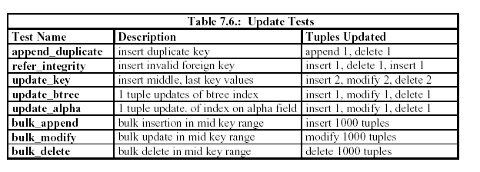
AS3AP Benchmark
Update test

Slide 44
Conclusions WISC & AS3AP
Observation:
Database system performance differ widely
A benchmark suite is a collection of database tasks which
should have a precisely articulated goal
should be minimal
should be scalable
should have an associated metric

Slide 45
Performance Benchmarks
Commonly used performance measures:
  Response time (delay from submission of transaction to return of result)
  Throughput (transactions per second, or tps)
  Availability or mean time to failure
  Speedup (linear->twice as much resources reduces time half)
  Scaleup (response time remains constant with increasing load and resources)
  Sizeup (doubling the size does not double required resources)

Slide 46
Issues in Metric Selection
Response time metric
  Do you measure arrival of first or last result?
How to deal with outliers ?
How to avoid tampering of results ?
How to catch complex behaviour in a single number?

Slide 47
Performance Benchmarks (Cont.)
Beware when computing average throughput of different transaction types
  E.g., suppose a system runs transaction type A at 99 tps and transaction type B at 1 tps.
  Given an equal mixture of types A and B, throughput is not (99+1)/2 = 50 tps.
  Running one transaction of each type takes time 1+.01 seconds, giving a throughput of 1.98 tps (= 2/1.01).
  Interference (e.g. lock contention) makes even this incorrect if different transaction types run concurrently

Slide 48



Metric Selections
Arithmetic mean
Geometric mean
Harmonic mean

Slide 49

Metric Selections
Arithmetic mean
Geometric mean

Slide 50

Metric Selections
Geometric mean
Move away from zero to “level” impact

Slide 51
Metric Selections
Criteria
  Easy to explain in mathematical terms to users
  Non-hypersensitivity
  Scalability translates to easy change of metric
  Balance to capture delta changes in outlier positions
  Easy translation to operational decisions
How to relate performance metric to an application field ?

Slide 52
Database Application Classes
Online transaction processing (OLTP)
  requires high concurrency and clever techniques to speed up commit processing, to support a high rate of update transactions.
Decision support applications
  including online analytical processing, or OLAP applications, require good query evaluation algorithms and query optimization.
Embedded applications
  Requires small footprint, small database storage

Slide 53
Benchmarks Suites
The Transaction Processing Council (www.tpc.org) benchmark suites are widely used.
  TPC-A and TPC-B: simple OLTP application modeling a bank teller application with and without communication
    Not used anymore
  TPC-C: complex OLTP application modeling an inventory system
    Current standard for OLTP benchmarking

Slide 54
Benchmarks Suites (Cont.)
TPC benchmarks (cont.)
  TPC-D: complex decision support application
    Superceded by TPC-H and TPC-R
  TPC-H: (H for ad hoc)
    Models ad hoc queries which are not known beforehand
      Total of 22 queries with emphasis on aggregation
    prohibits materialized views
    permits indices only on primary and foreign keys
  TPC-R: (R for reporting) same as TPC-H, but without any restrictions on materialized views and indices
  TPC-W: (W for Web) End-to-end Web service benchmark modeling a Web bookstore, with combination of static and dynamically generated pages

Slide 55
TPC Performance Measures
TPC performance measures
  transactions-per-second with specified constraints on response time
  transactions-per-second-per-dollar accounts for cost of owning system
TPC benchmark requires database sizes to be scaled up with increasing transactions-per-second
  reflects real world applications where more customers means more database size and more transactions-per-second
External audit of TPC performance numbers mandatory
  TPC performance claims can be trusted

Slide 56
TPC Performance Measures
Two types of tests for TPC-H and TPC-R
  Power test: runs queries and updates sequentially, then takes mean to find queries per hour
  Throughput test: runs queries and updates concurrently
    multiple streams running in parallel each generates queries, with one parallel update stream
  Composite query per hour metric: square root of product of power and throughput metrics
  Composite price/performance metric

Slide 57
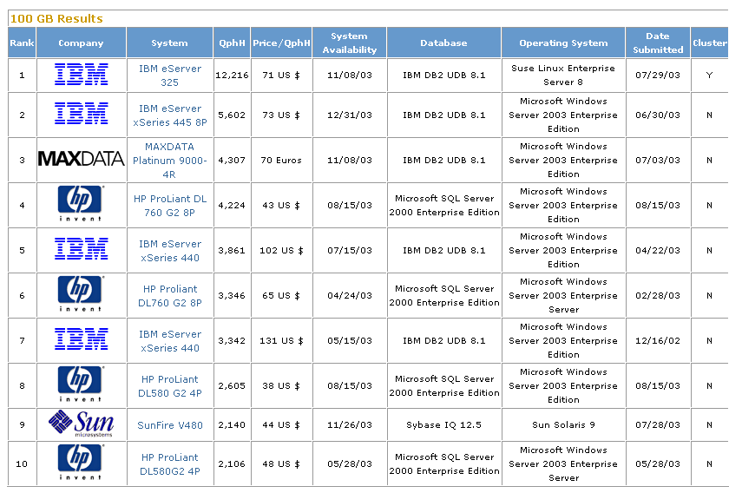

Slide 58
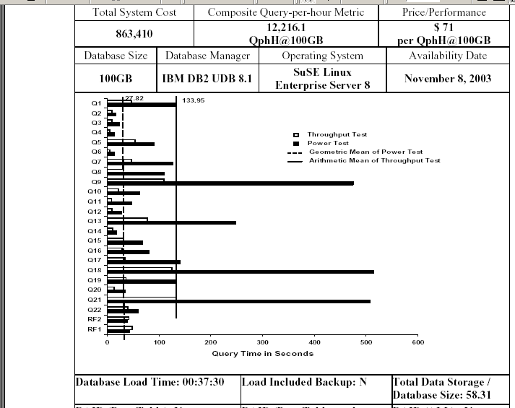

Slide 59
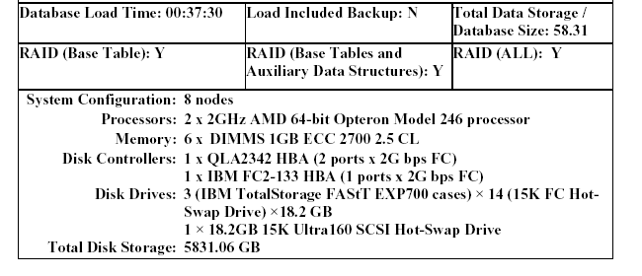

Slide 60
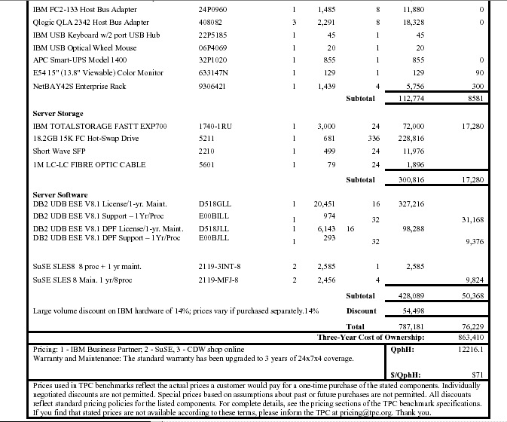

Slide 61
Learning points
  Performance of a DBMS is determined by many tightly interlocked components
  A benchmark is a ‘clean room’ setting to study their behaviour from an algorithmic/application viewpoint
  Key performance indicators are: response time, throughput, IOs, storage size, speed-up, scale-up

